Slide 1





Slide 2
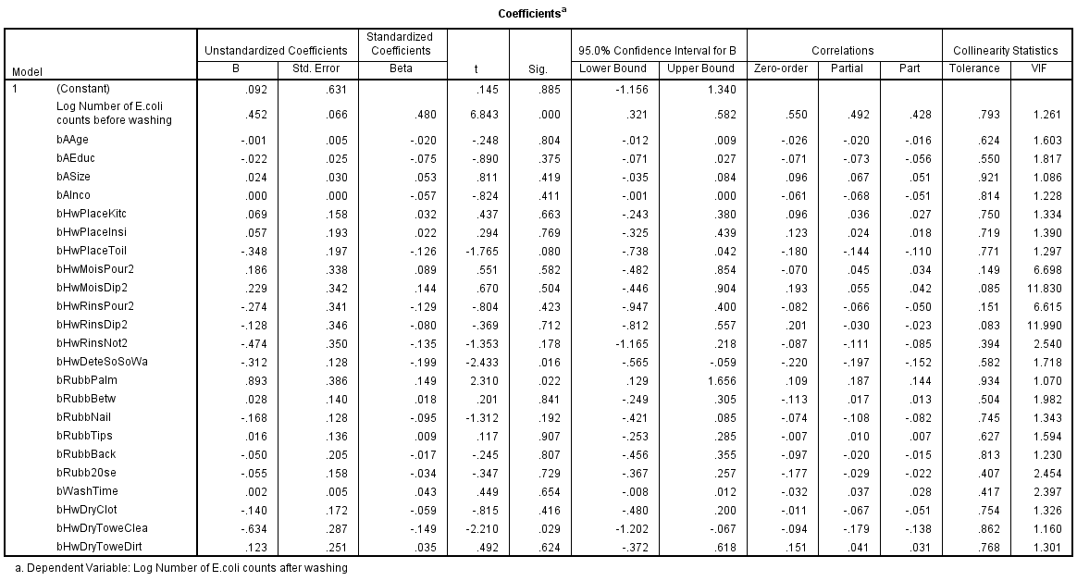
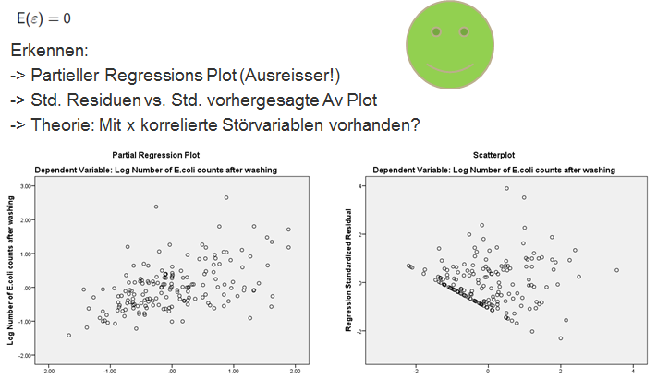
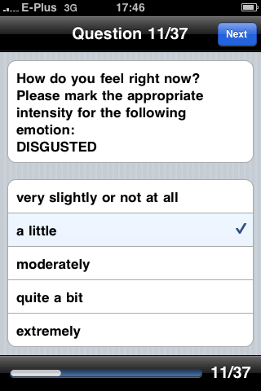
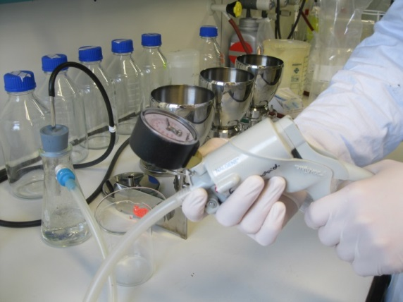
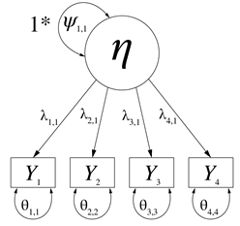

Slide 3
Dear Author,
You call this research, I call it shit, and I tell you why.
… Being suspicious about your analysis, we repeated your calculations. Due to violation of various assumptions, your regression results are neither trustworthy nor worth anything else. Perhaps Mickey Mouse might be a serious enough publisher for your research.
I suggest you a deal: If you find out yourself which assumptions are violated AND present an appropriate solution, I will further consider your Mickey Mouse manuscript for publication.
Pledge for resubmit after major revision! Good luck and good speed!
p.s. To give you some hints, we give some thoughts on your data.
Let us discuss the issues in detail…

Slide 5

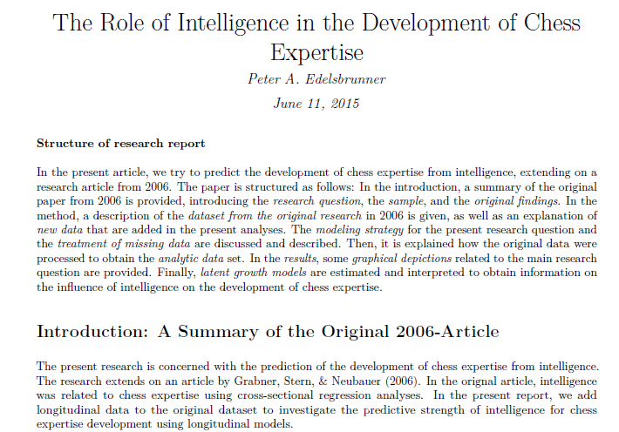


Slide 6
